Slide 1







what
buyers
said
Everything blue is a guide. Delete it before you download.
Notes:
Slide 1. Hook. Swap in a photo of your product.

Slide 2
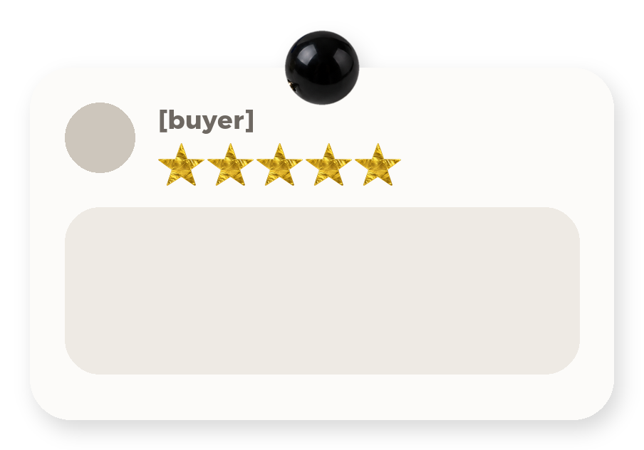
[don't take
my word for it]
[the review, word
for word]
[here's theirs]
Notes:
Slide 2. Second hook: Instagram often shows a carousel starting on slide 2, so this one works as a cover on its own. Paste a real review, word for word.

Slide 3
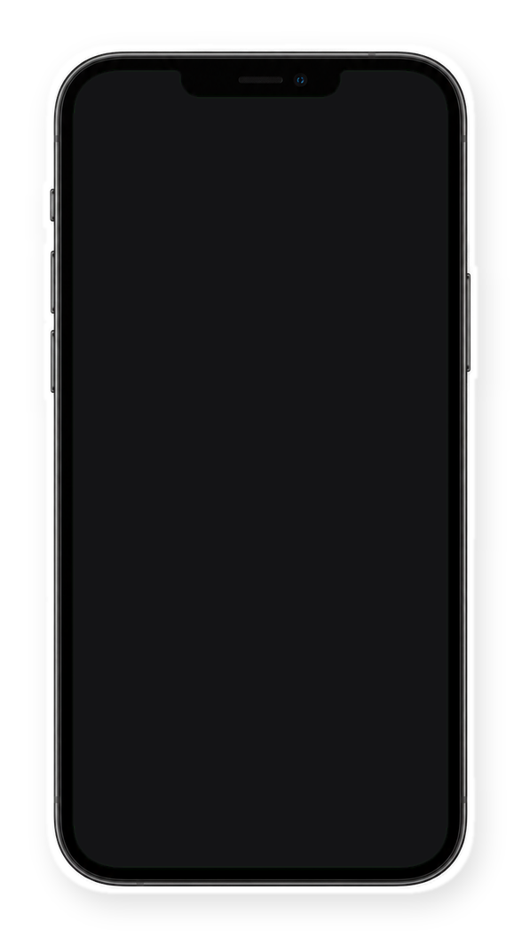

[straight from
my DMs]
Notes:
Slide 3. Swap in a screenshot of a real review or DM for the phone screen.

Slide 4
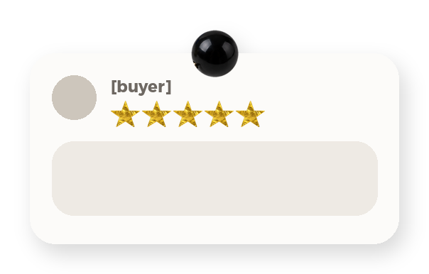


[review two]
[review three]
[review four]
Notes:
Slide 4. Three more reviews round your product photo.

Slide 5

[200]
happy buyers
Notes:
Slide 5. Your real number of happy buyers (or reviews). Edit it.

Slide 6


[what they love most]
Notes:
Slide 6. Swap in a photo of your product in use. Edit the line.

Slide 7


see why
Comment
"[KEYWORD]"
Notes:
Slide 7. Swap in a photo of your product. Type your keyword. Caption to start from (CTA in the first two sentences, 3 hashtags): Comment [KEYWORD] and I will send you [the link]. [One line of real context: who it helps or how you use it.] #[tag] #[tag] #[tag]

